Slide 1
Project Progress Report
Team 07 Department of Artificial Intelligence Cyber Security College of Science & Technology

Slide 2

Contents
Structure We Used
Development Progress
Organization: https://github.com/ku-aics201-23s-team07

Slide 3
Strurcture We Used

Slide 4
Structure We Used
Node Sorting
AVL-tree
Node Searching
Stack
Heap
Node Filtering
List

Slide 5
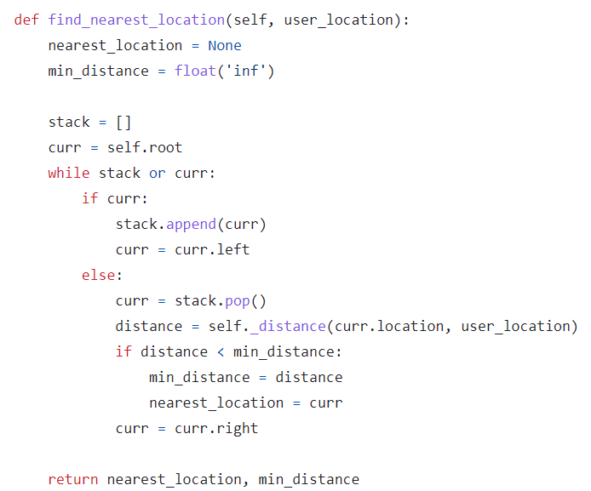
Development Progress
Node Sorting
AVL-tree
Node Searching
Stack
Heap
Node Filtering
List

Slide 6
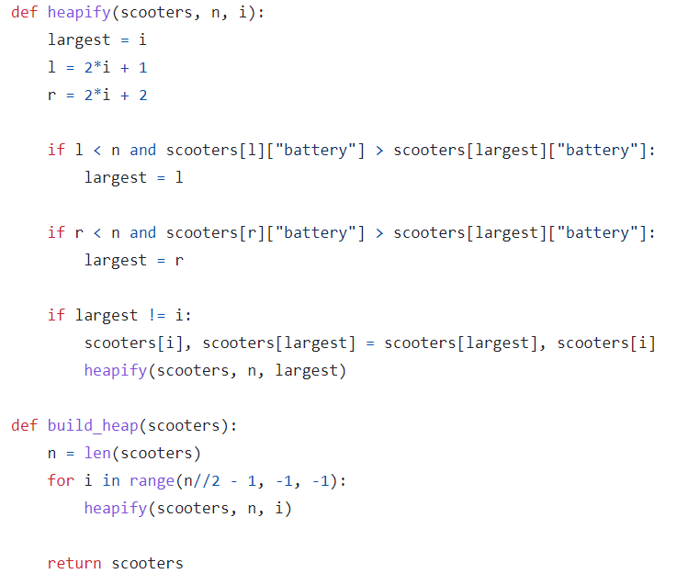
Development Progress
Node Sorting
AVL-tree
Node Searching
Stack
Heap
Node Filtering
List

Slide 7
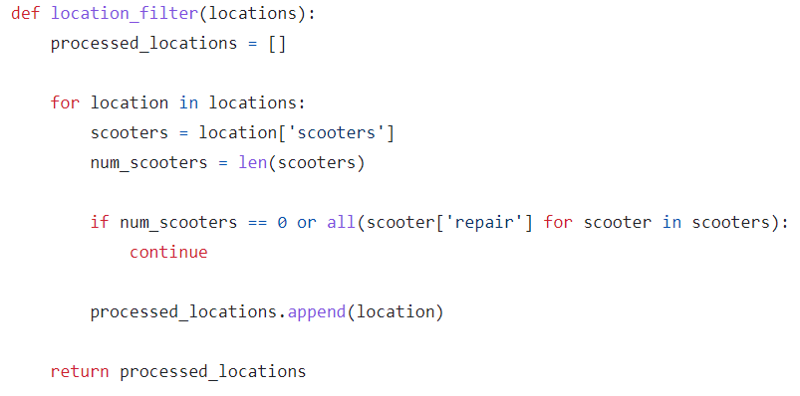
Development Progress
Node Sorting
AVL-tree
Node Searching
Stack
Heap
Node Filtering
List

